Slide 1

Global Education completion Rate vs Unemployment problem
CS 2704: Data Analytics with Python
Name: Yasin Rahman
ID: 3733078

Slide 2
Brief Explanation
This study aims to explore the various dimensions of educational outcomes in the context of global education. These dimensions include gender differences in educational achievement, degrees of educational completion, and reading and writing ability. The hypothesis suggests that there is a noteworthy relationship between these various aspects of education, with the expectation that differences in one area may affect results in other areas. The aim is to clarify complex connections and identify trends that advance a thorough comprehension of the dynamics of global education.
Data Set: https://www.kaggle.com/datasets/nelgiriyewithana/world-educational-data/data
GitHub: https://github.com/YasinRahman18/World-Education

Slide 3
Hypothesis
There is a negative correlation between the level of education and the unemployment rate globally. In other words, as the level of education increases, the unemployment rate decreases.
This theory is predicated on the idea that people with greater educational attainment are more qualified and have a wider range of abilities, which increases their employability. It's crucial to remember, though, that a wide range of other factors, such as governmental regulations, industry growth, and economic conditions, can affect unemployment rates. Consequently, while education can have a big impact, unemployment rates are not only determined by it. To test this theory and ascertain the degree and importance of the association, more investigation and data analysis would be required.

Slide 4
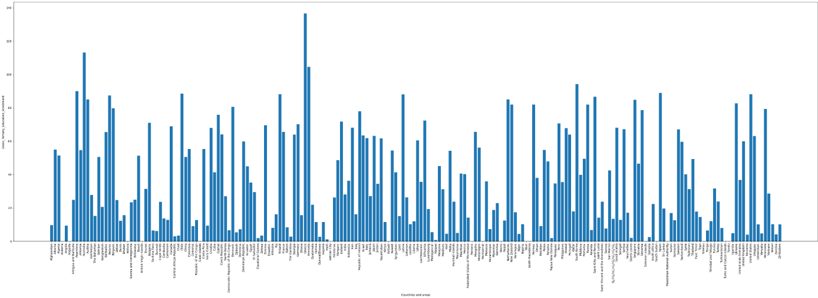
Global Education Enrollment
Global education enrollment refers to the number of students who are registered in educational institutions worldwide. It is a key indicator of access to education and can provide insights into a country’s commitment to providing education for its citizens. Here is a bar chart

Slide 5
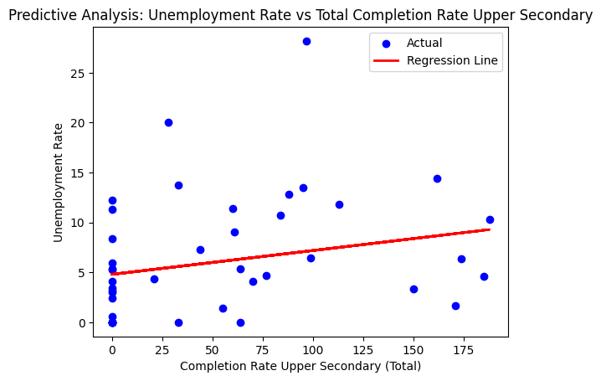
Predictive analysis

Slide 6
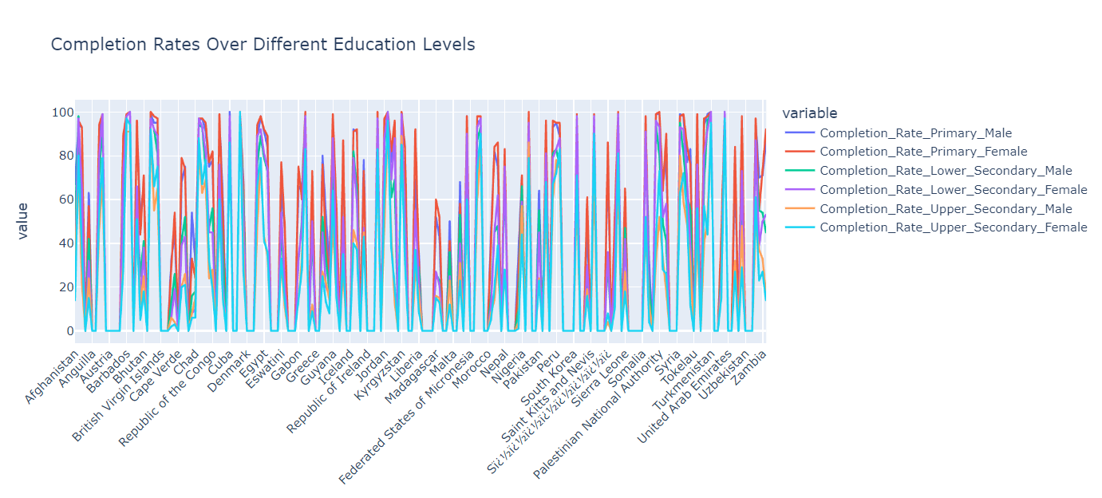
Completion Rates Over Different Education Levels in Different countries Here is a Line chart:

Slide 7
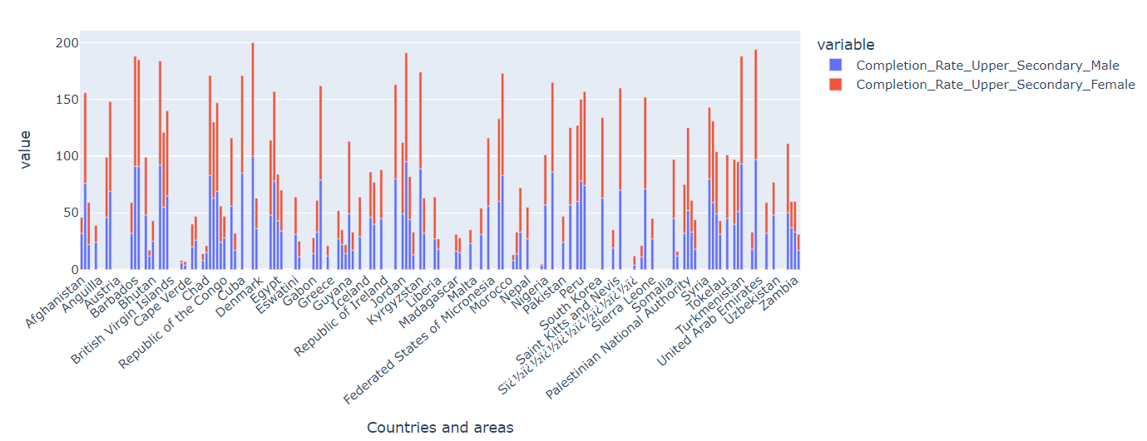
Education Rate of Males and Females upto Higher Secondary by Countries

Slide 8
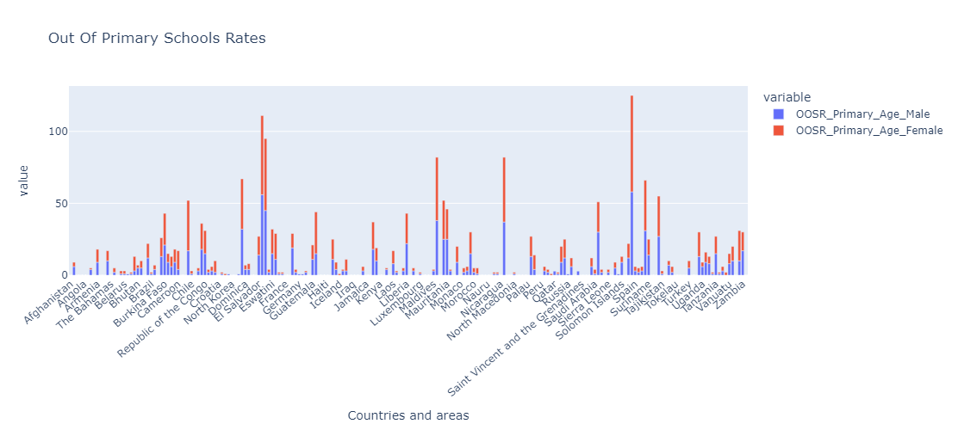
Out of school at Primary Education

Slide 9
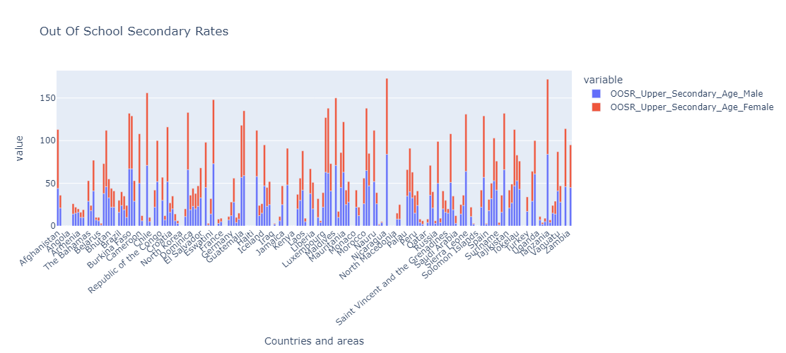
Out of Secondary Education

Slide 10
T-Test of Completion of Male and Female of Higher Secondary Education
T-Statistic: -0.1312743507842733
P-Value: 0.8956239525186745
The difference is not statistically significant.

Slide 11
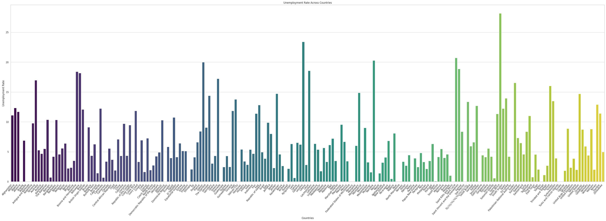
Unemployment Rate by Countries

Slide 12
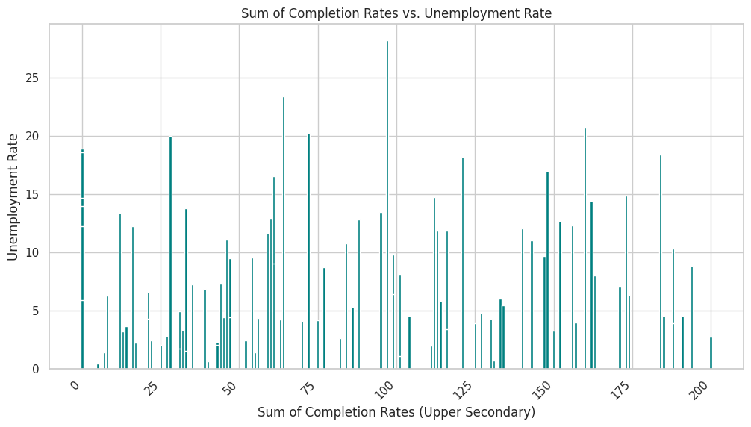
Education Rate Vs Unempolyment

Slide 13
Relationship between Education and Unemployment
Performing linear Regression analysis we try to establish a relationship between education and unemployment.
Coefficient P-value const
4.859201 1.721603e-21
Total Completion Rate 0.024934 6.152914e-05
There is a statistically significant relationship between education and unemployment.

Slide 14
Conclusion
Based on the analysis of the data, we can conclude that there is a significant relationship between education completion rates and unemployment rates. The data suggests that as the education completion rate increases, the unemployment rate decreases. This trend is consistent across different regions and countries, indicating that education plays a crucial role in employment opportunities.
While education is a key factor in employment, but it is not the only factor.

